Slide 1
Object Oriented Programming (OOP)
2020

Slide 2
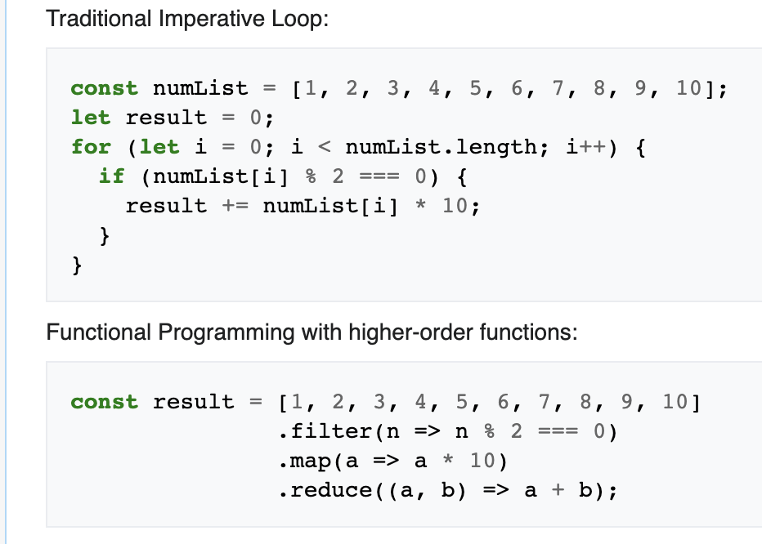
Programming Paradigms
Programming Paradigm - is a style of programming
Imperative programming tells us how to do it, while Declarative programming tells us what we want to happen
Imperative
Procedural
Object Oriented
Declarative
Functional
Reactive
….

Slide 3
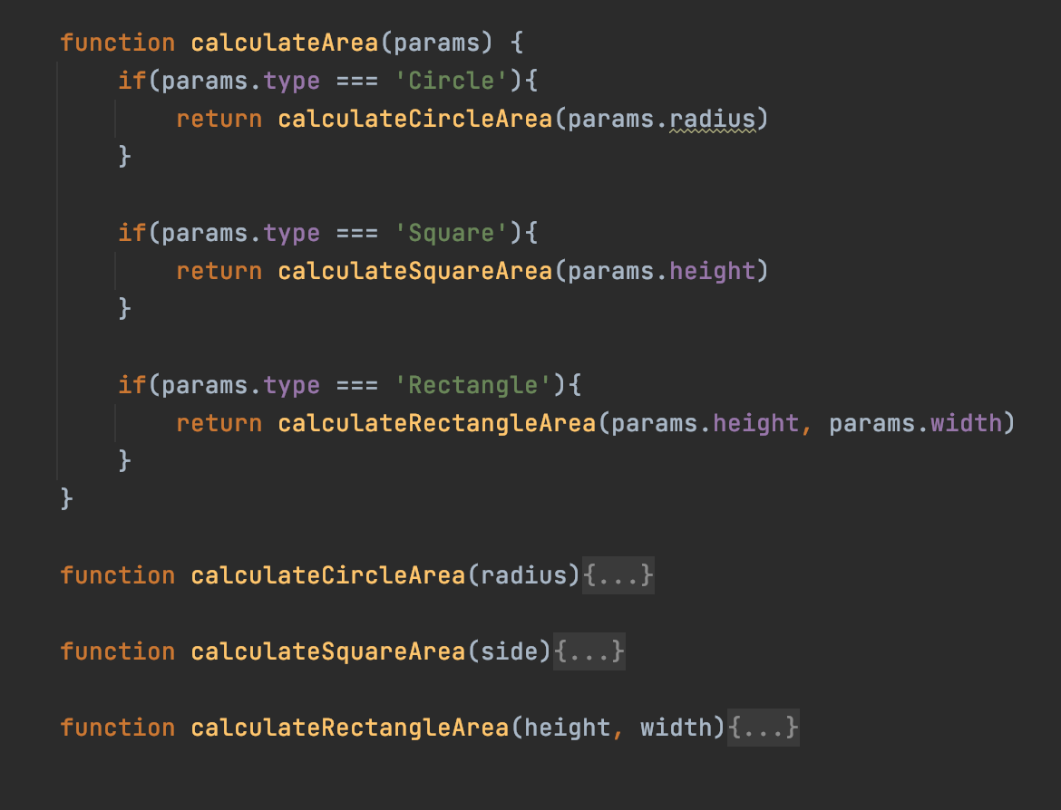
Procedural Style
Pros
Works well for simple general purpose tasks
Cons
Extensibility
Maintainability
Reusability

Slide 4
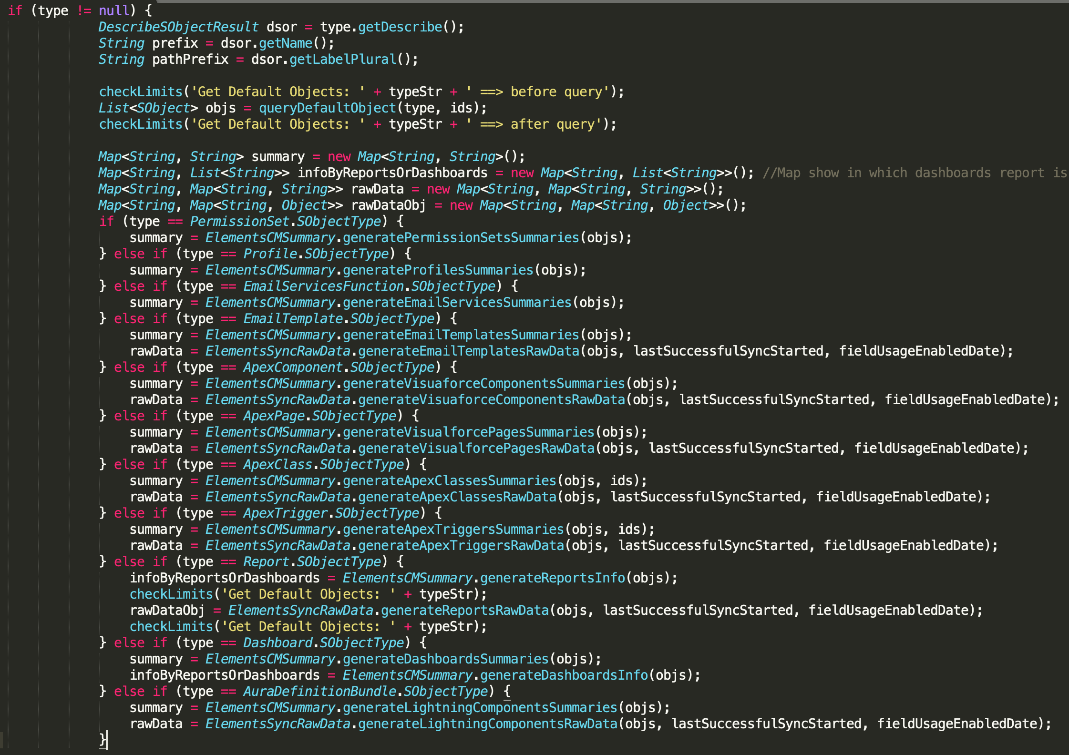
Procedural Style. Real-project example

Slide 5
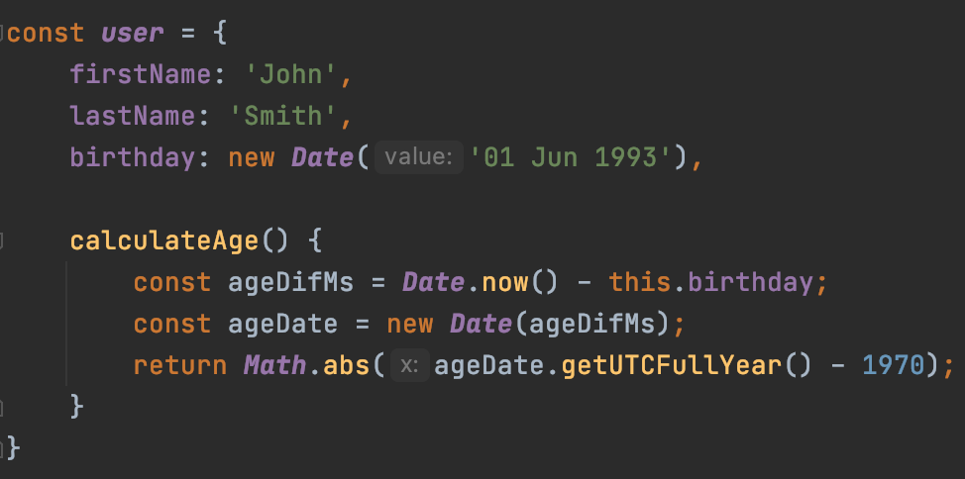
Objects in OOP have
Fields
State
Behaviour

Slide 6
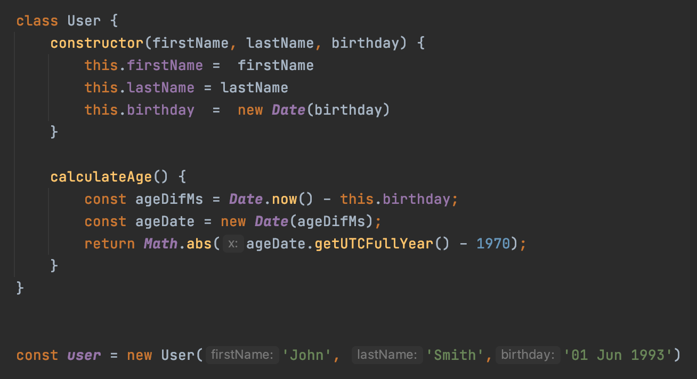
Classes
Class is an extensible program-code-template for creating objects, providing initial values for state and implementations of behavior
Objects are instantiated with the help of new operator

Slide 7
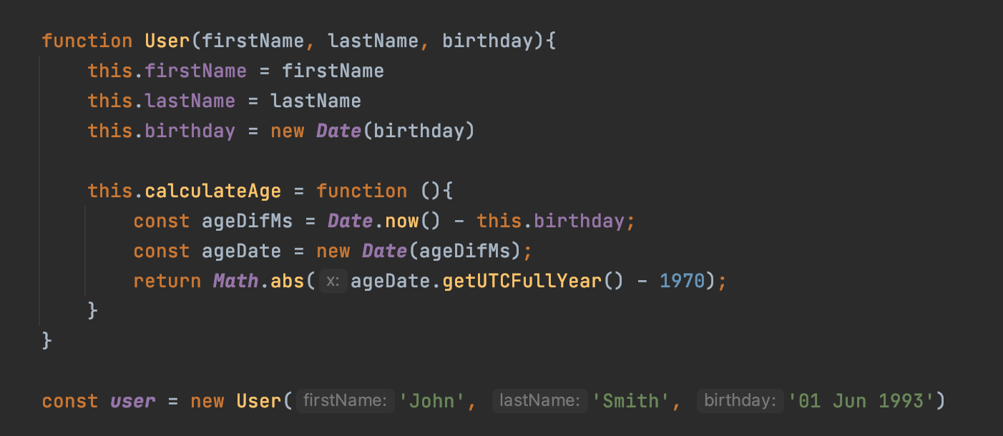
Constructor Function
Name should start with capital letter by convention

Slide 8
OOP Principles
Encapsulation
Inheritance
Polymorphism

Slide 9
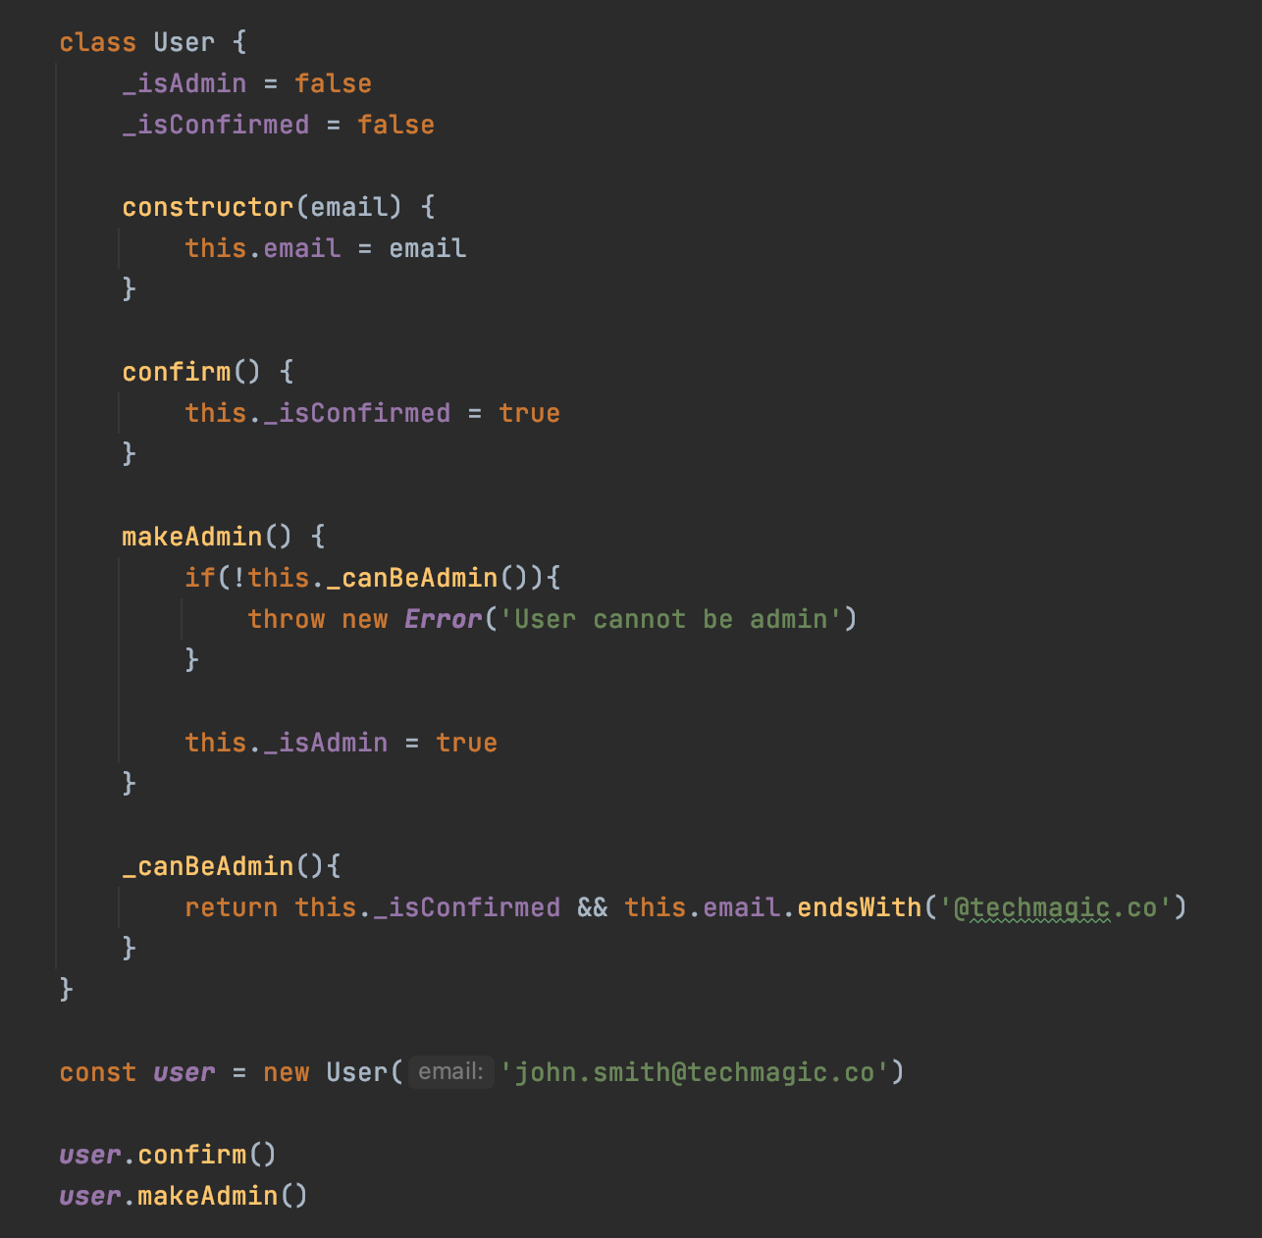
Encapsulation
Internal object state should be protected from changes, all changes should be done only through object methods
Module, package, entire system can also be treated as Object in OOP

Slide 10
Inheritance
Inheritance is a mechanism in which one class (child) acquires the property of another class (parent)
Inheritance is a way to prevent code duplications
Rules of thumb
Build inheritance tree bottom to top
Use "is-a-type-of" condition
Do not abuse !

Slide 11
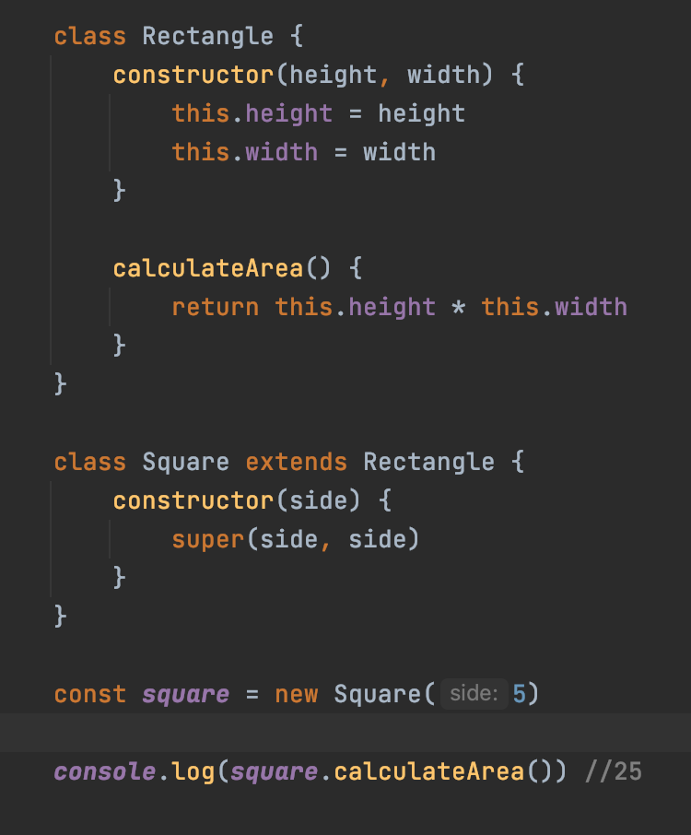
Inheritance with JavaScript Classes

Slide 12
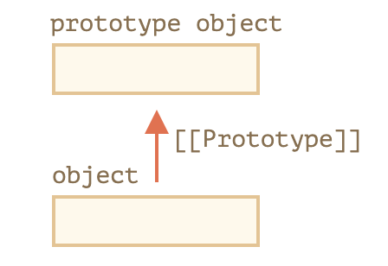
Prototypes
In JavaScript, objects have a special hidden property [[Prototype]], that is either null or references another object. That object is called “a prototype”:
The prototype is only used for reading not for writing

Slide 13
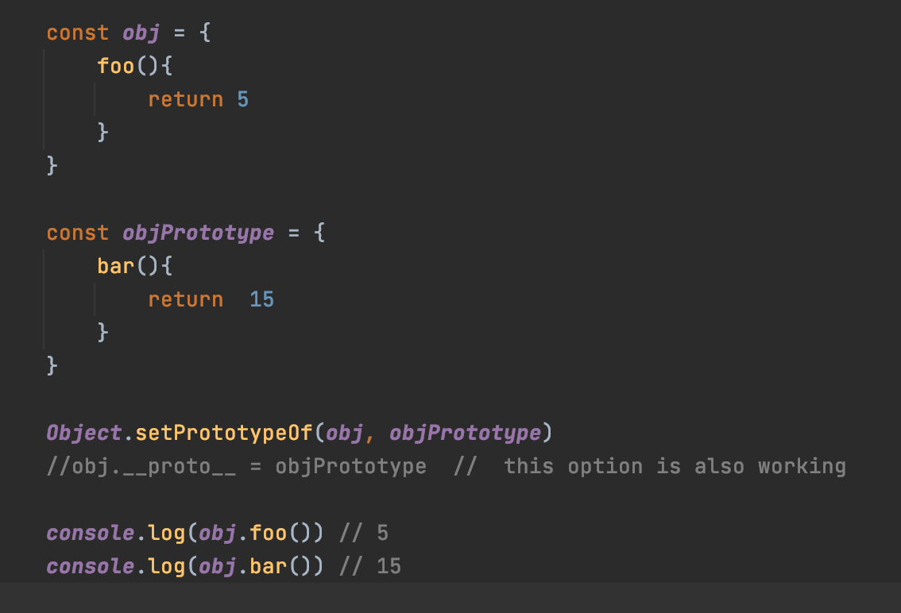
Accessing Prototypes
__proto__ is a historical getter/setter for [[Prototype]]
modern JavaScript suggests
Object.getPrototypeOf
Object.setPrototypeOf

Slide 14
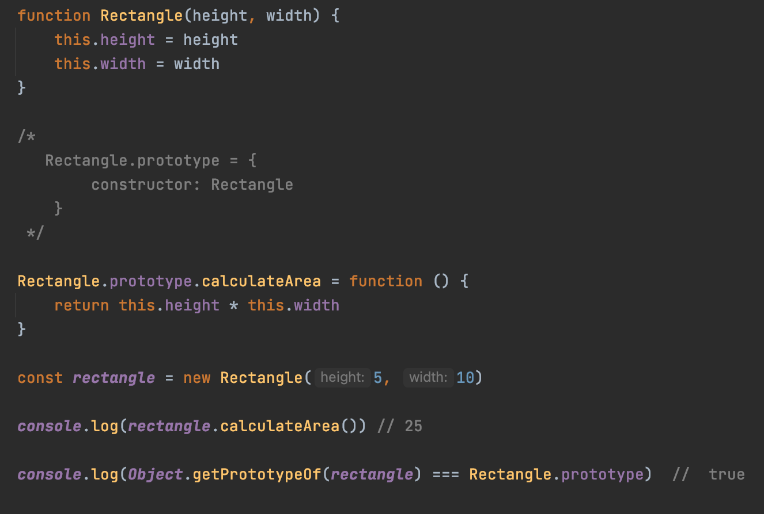
F.prototype
If F.prototype is an object, then the new operator uses it to set [[Prototype]] for the new object

Slide 15
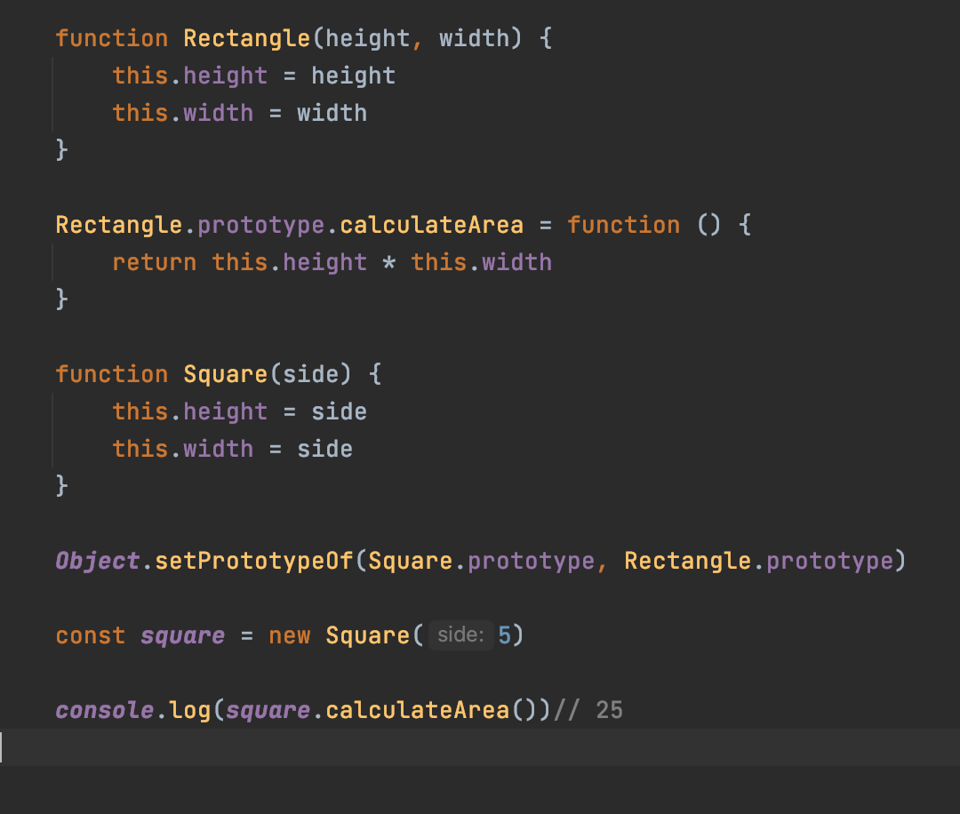
F.prototype & Inheritance

Slide 16
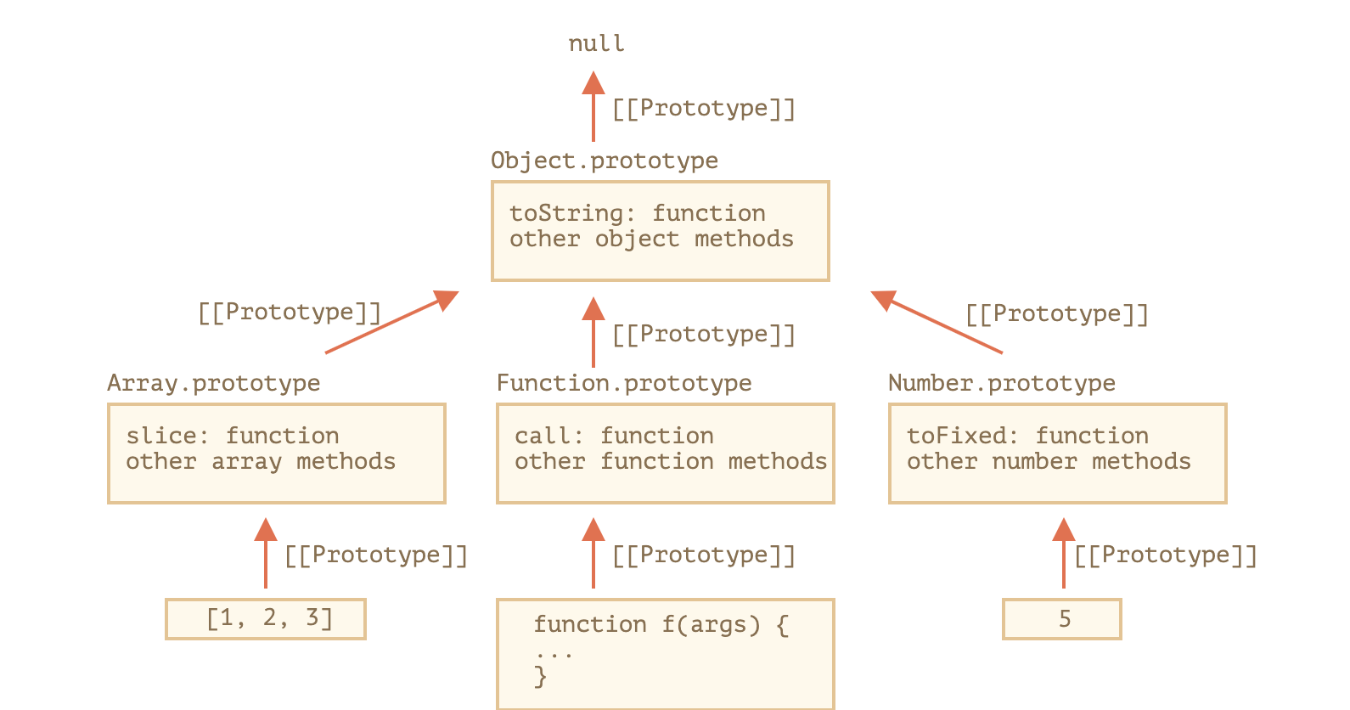
Native Prototypes

Slide 17
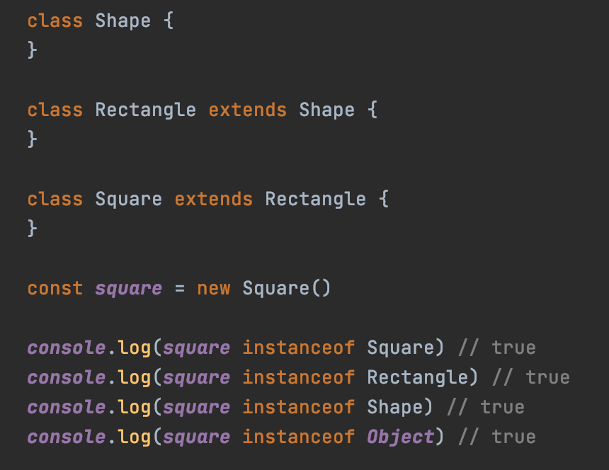
Instanceof
The instanceof operator allows to check whether an object belongs to a certain class. It also takes inheritance into account.

Slide 18
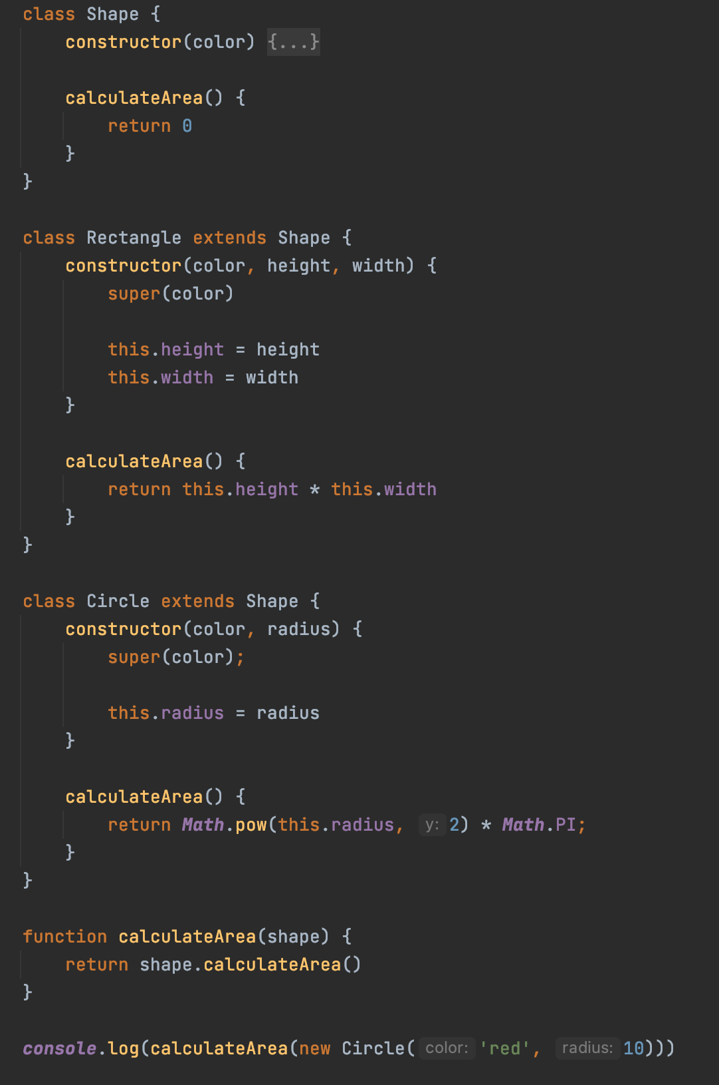
Polymorphism
Polymorphism is when calling code can be agnostic as to whether an object belongs to a parent class or one of its descendants
Behaviour depends on concrete descendant type

Slide 19
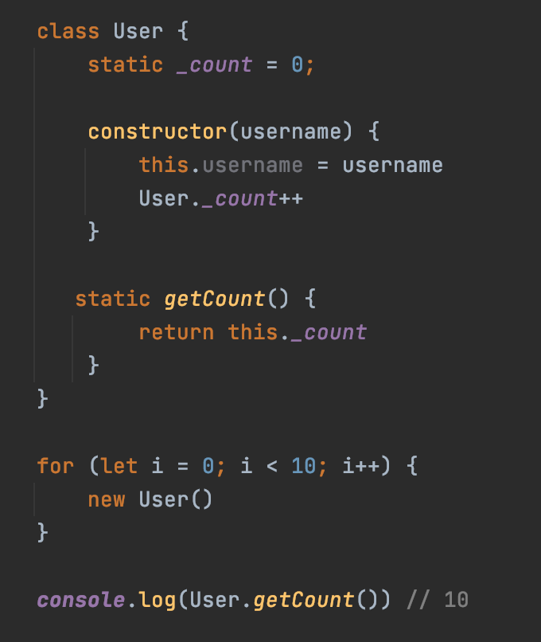
Static Members
We can also assign methods and properties to the class function, not to its "prototype". Such methods are called static.

Slide 20
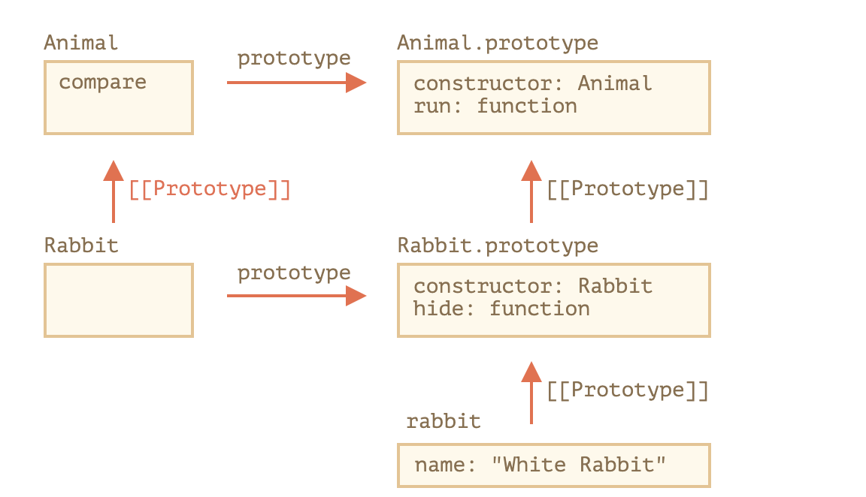
Static Part Inheritance

Slide 21
Materials
OOP basics lecture
https://learn.javascript.ru/

Slide 22
Homework
Imagine that you are going to work on Smart Home Management System, your goal is to show the first-iteration demo to the client
TODOs:
Perform decomposition
What real-world items the system will consist of?
Build a class-diagram to represent relations between classes (suggestion)
Implement a solution that must include examples of:
Inheritance
Encapsulation
Polymorphism
Static properties utilization
Create demo.js script to show what the system is able to do

